Slide 1

TPO Presentation
Tuesday, January 22, 2013
Corridor Improvement Program (CIP) Phase I:
Assessment of US 17-92
Rural Preservation
TOD
Redevelopment
County to
Freight Movement
Multi-Modal
County Travel

Slide 2

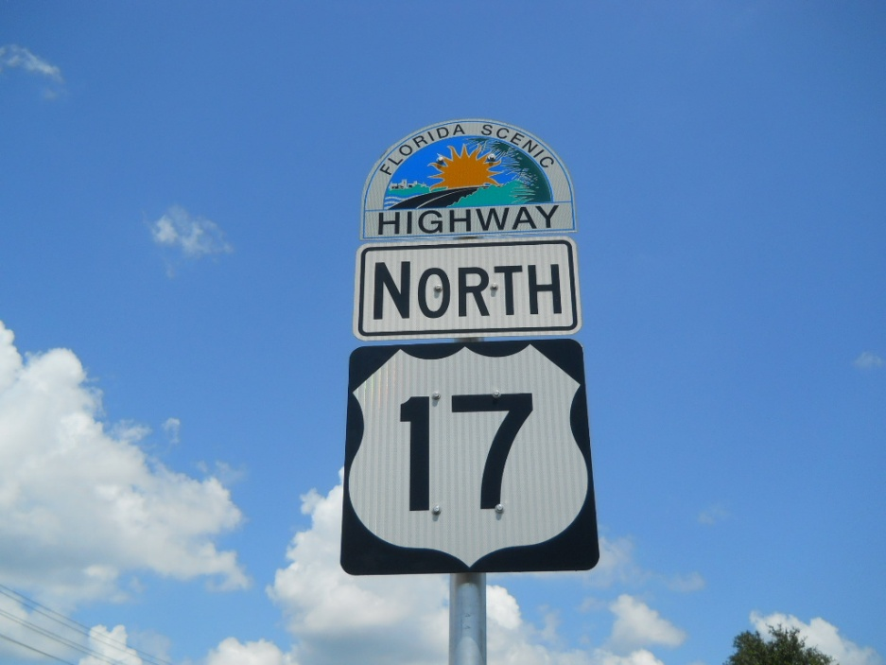
Review of Final Draft
Seeking approval of changes and comments on the final draft
Draft document has been revised to address all prior comments and recommendation from Stakeholders
Primary purpose-data collection and dissemination

Slide 3
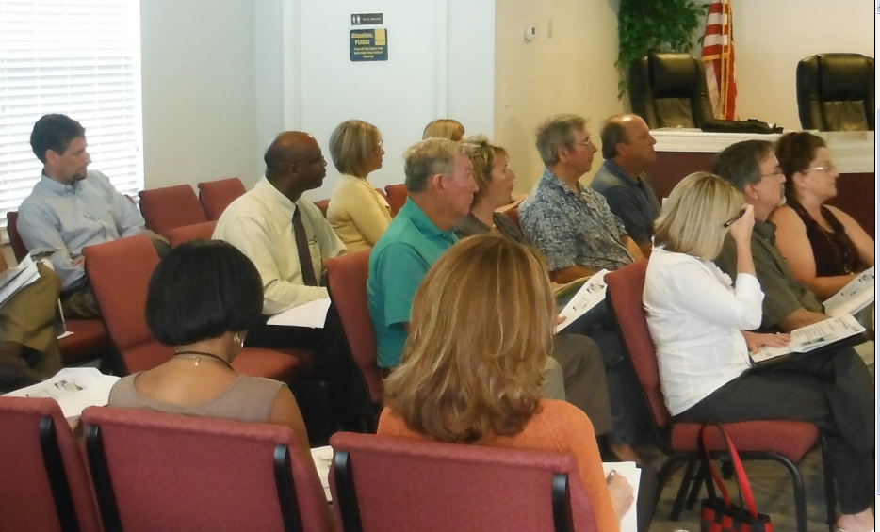
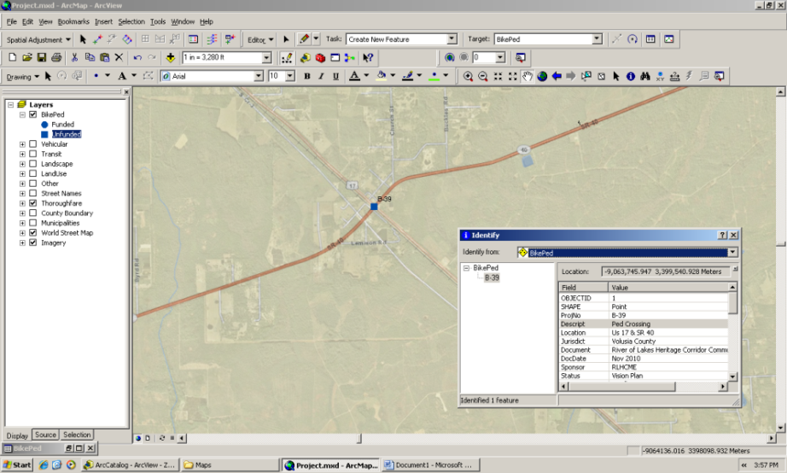
Executive Summary
Assist with disseminating technical information
Section 1. Introduction and Overview
Study Area
Study Purpose/Process
Compilation/GIS Interface
  Approved and Adopted Studies/Plans
  Categories and Themes
  Complimentary or Conflicting
  Appendices Contain the List of Studies; the Project List; and, the One-on-One Stakeholder Meeting Summaries

Slide 4
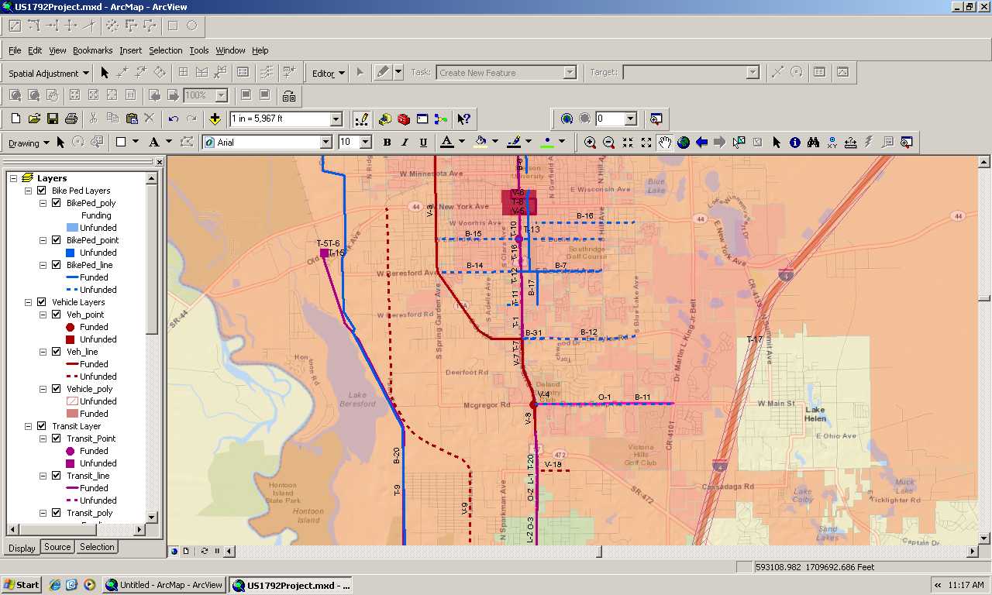
Screen showing all categories of projects

Slide 5
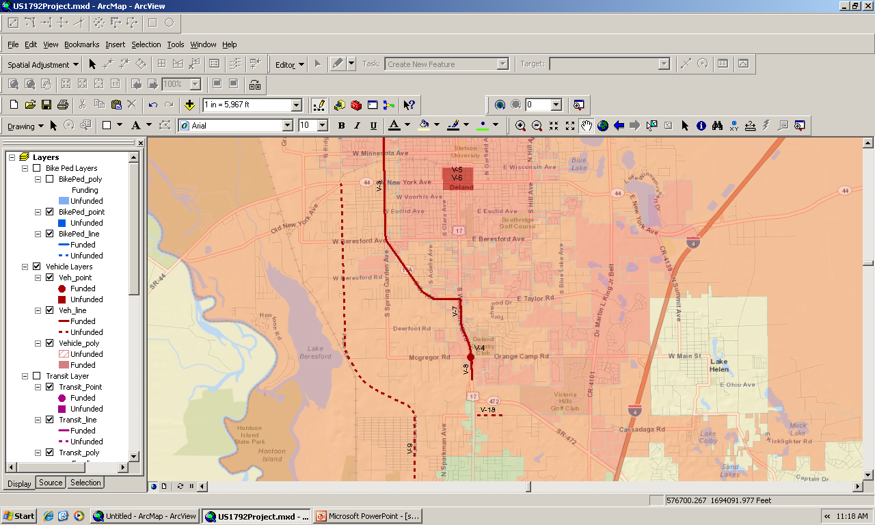
Screen showing all “Vehicular” projects-dashed=unfunded; solid=funded; square=unfunded; circle=funded

Slide 6
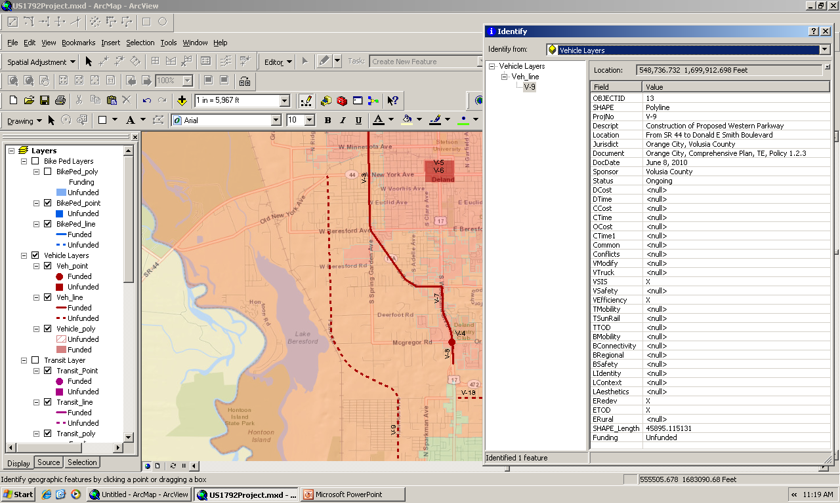
Table showing themes and attributes of the project

Slide 7
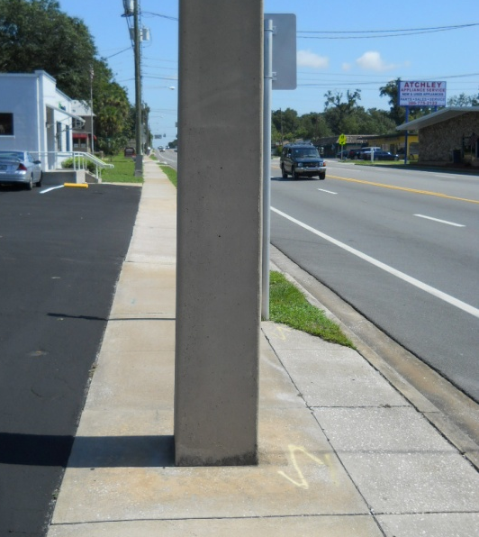
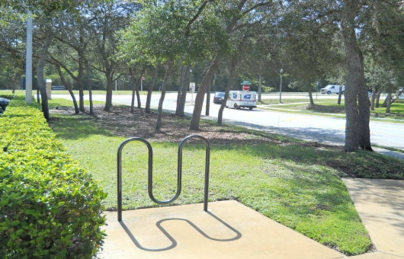
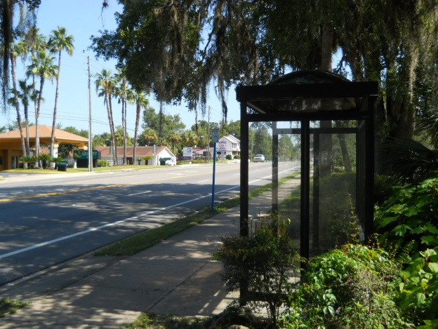
Section 2. Summary of Existing Conditions
Identified the 19 Sections-physical and operational conditions identified.
School Attendance Areas
ADA Compliance
Pavement Condition
Transit Service
Crash Data

Slide 8
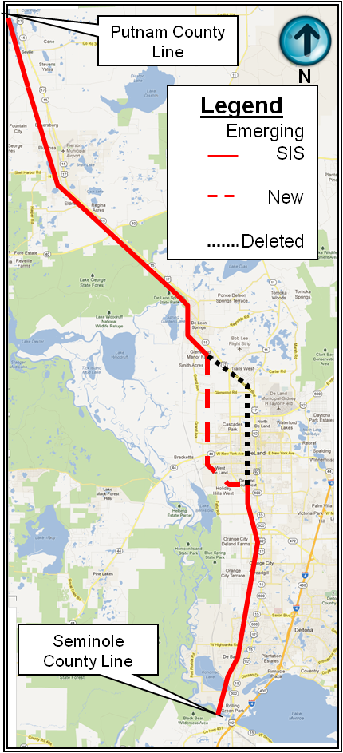
Section 3. Analysis of Roadway Designation
Overview of Functional Classification and SIS Design Standards
Design Speed
Access Management/Median Design
Freight Movement
Traffic Calming/Context-Sensitive Solutions/Transportation Design for Liveable Communities (TDLC)
Transit Function

Slide 9
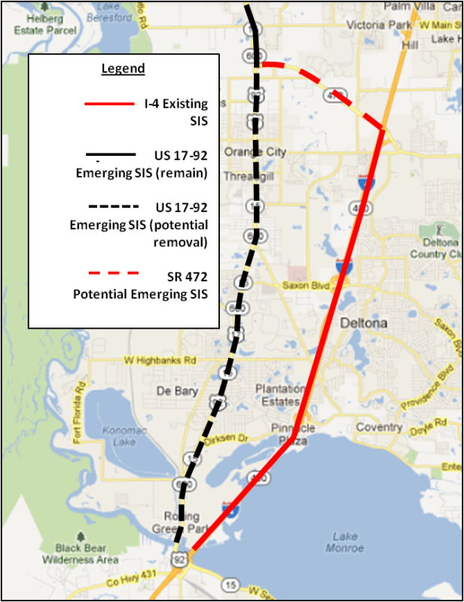
Section 3, Analysis of Roadway Designations (cont.)
Regulatory and Fiscal Impacts
Community Planning Act/LOS Issues
Relocation of SIS Designation
Impacts on Planned Developments
SIS Funding

Slide 10
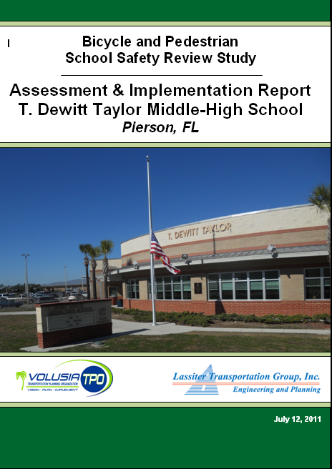
Issues for Future Discussion
Complete Streets initiatives in South Section
I-4/SR 472 SW Activity Center DRI mitigations-no widening of US 17-92 in Orange City
Transit importance
School, pedestrian, bicyclist safety
River of Lakes Scenic Highway Corridor Management Plan
Freight Movement
Wal-Mart impacts

Slide 11


Comments from Stakeholders, CAC and TCC Members
Relocation of SIS designation will not impact segment between SR 472 and Taylor Road (SR 15A)
Relocation of SIS from US 17-92 to I-4/SR 472 has not been officially reviewed by impacted local governments. Discussion still at staff level for many communities
Application of design variances from SIS standards (i.e. TDLC) is not an automatic process
The list of projects is not a ranking or assessment of the projects-it’s just a list
Truck traffic cannot be prohibited on a US Highway
SIS funding is available for minor operational improvements, subject to approval from FDOT
Transit and connectivity with SunRail has to be inclusive of those communities outside the corridor

Slide 12
Status
Reviewed and Updated Findings with Stakeholders
Complete GIS-based Mapping Projects
Finalize Draft Report
Hold Draft Workshop with Stakeholders
Present Draft Report to CAC and TCC on Tuesday, January 15th

Slide 13
Status
Review and Update Findings with Stakeholders
Completed GIS-based Mapping Projects
Finalize Draft Report
Hold Draft Workshop with Stakeholders
Present Draft Report to CAC and TCC on Tuesday, January 15th

Slide 14
Status
Review and Update Findings with Stakeholders
Complete GIS-based Mapping Projects
Finalized Draft Report
Hold Draft Workshop with Stakeholders
Presented Draft Report to CAC and TCC on Tuesday, January 15th

Slide 15
Status
Review and Update Findings with Stakeholders
Complete GIS-based Mapping Projects
Finalized Draft Report
Held Draft Workshop with Stakeholders
Presented Draft Report to CAC and TCC on Tuesday, January 15th

Slide 16
Status
Review and Update Findings with Stakeholders
Complete GIS-based Mapping Projects
Finalized Draft Report
Hold Draft Workshop with Stakeholders
Presented Draft Report to CAC and TCC on Tuesday, January 15th

Slide 17



ONCE AGAIN, THANK YOU FOR YOUR TIME AND ASSISTANCE.

